Slide 1
DIGITAL PORTFOLIO
STUDENT NAME: SANJAY S
REGISTER NO AND NMID: 212400970/4A4F9C71E3AFC87B9564CC3CD3EF6E96
DEPARTMENT: BCA
COLLEGE: PRINCE SHRI VENKATESWARA ARTS AND SCIENCE COLLEGE

Slide 2

PROJECT TITLE
DIGITAL PORTFOLIO

Slide 3
AGENDA
1.Problem Statement
2.Project Overview
3.End Users
4.Tools and Technologies
5.Portfolio design and Layout
6.Features and Functionality
7.Results and Screenshots
8.Conclusion
9.Github Link

Slide 4
PROBLEM STATEMENT
Creating a personal portfolio website to showcase skills, projects, and contact details in a professional and visually appealing manner.

Slide 5
PROJECT OVERVIEW
The portfolio highlights academic background, technical skills, and completed projects. It serves as an online resume and professional identity.

Slide 6
WHO ARE THE END USERS ?
Recruiters, hiring managers, and peers who want to know more about my skills and projects.

Slide 7
TOOLS AND TECHNIQUES
• HTML
• CSS
• JavaScript

Slide 8
PORTFOLIO DESIGN AND LAYOUT
The portfolio is designed with a clean layout, featuring sections like About Me, Skills, Projects, and Contact.

Slide 9

FEATURES AND FUNCTIONALITY
• Responsive design
• Skills progress bars
• Project showcase
• Contact information with email, GitHub, and LinkedIn links

Slide 10
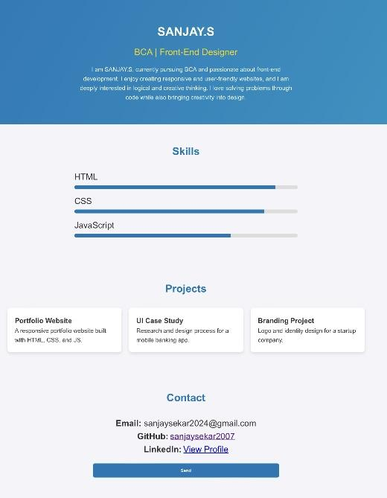
RESULTS

Slide 11
CONCLUSIONS
This project helped strengthen my front-end development skills. Future improvements may include adding animations and backend integration.

Slide 12
GITHUB LINK
https://sanjaysekar2007.github.io/TNSDC-FWD-DP-SANJAY-PORTFOLIO/

